Slide 1

Voice Controled Virtual Assistant
Guided by : Dr.Samson Ebenezar
Presentated By: Vishvanth U (1912260075) A.mohamed esha (1915260012)
K.Parvendhan (1919260009) M Gobinath (1919260014) Nishok Darshan (1921260044)

Slide 2


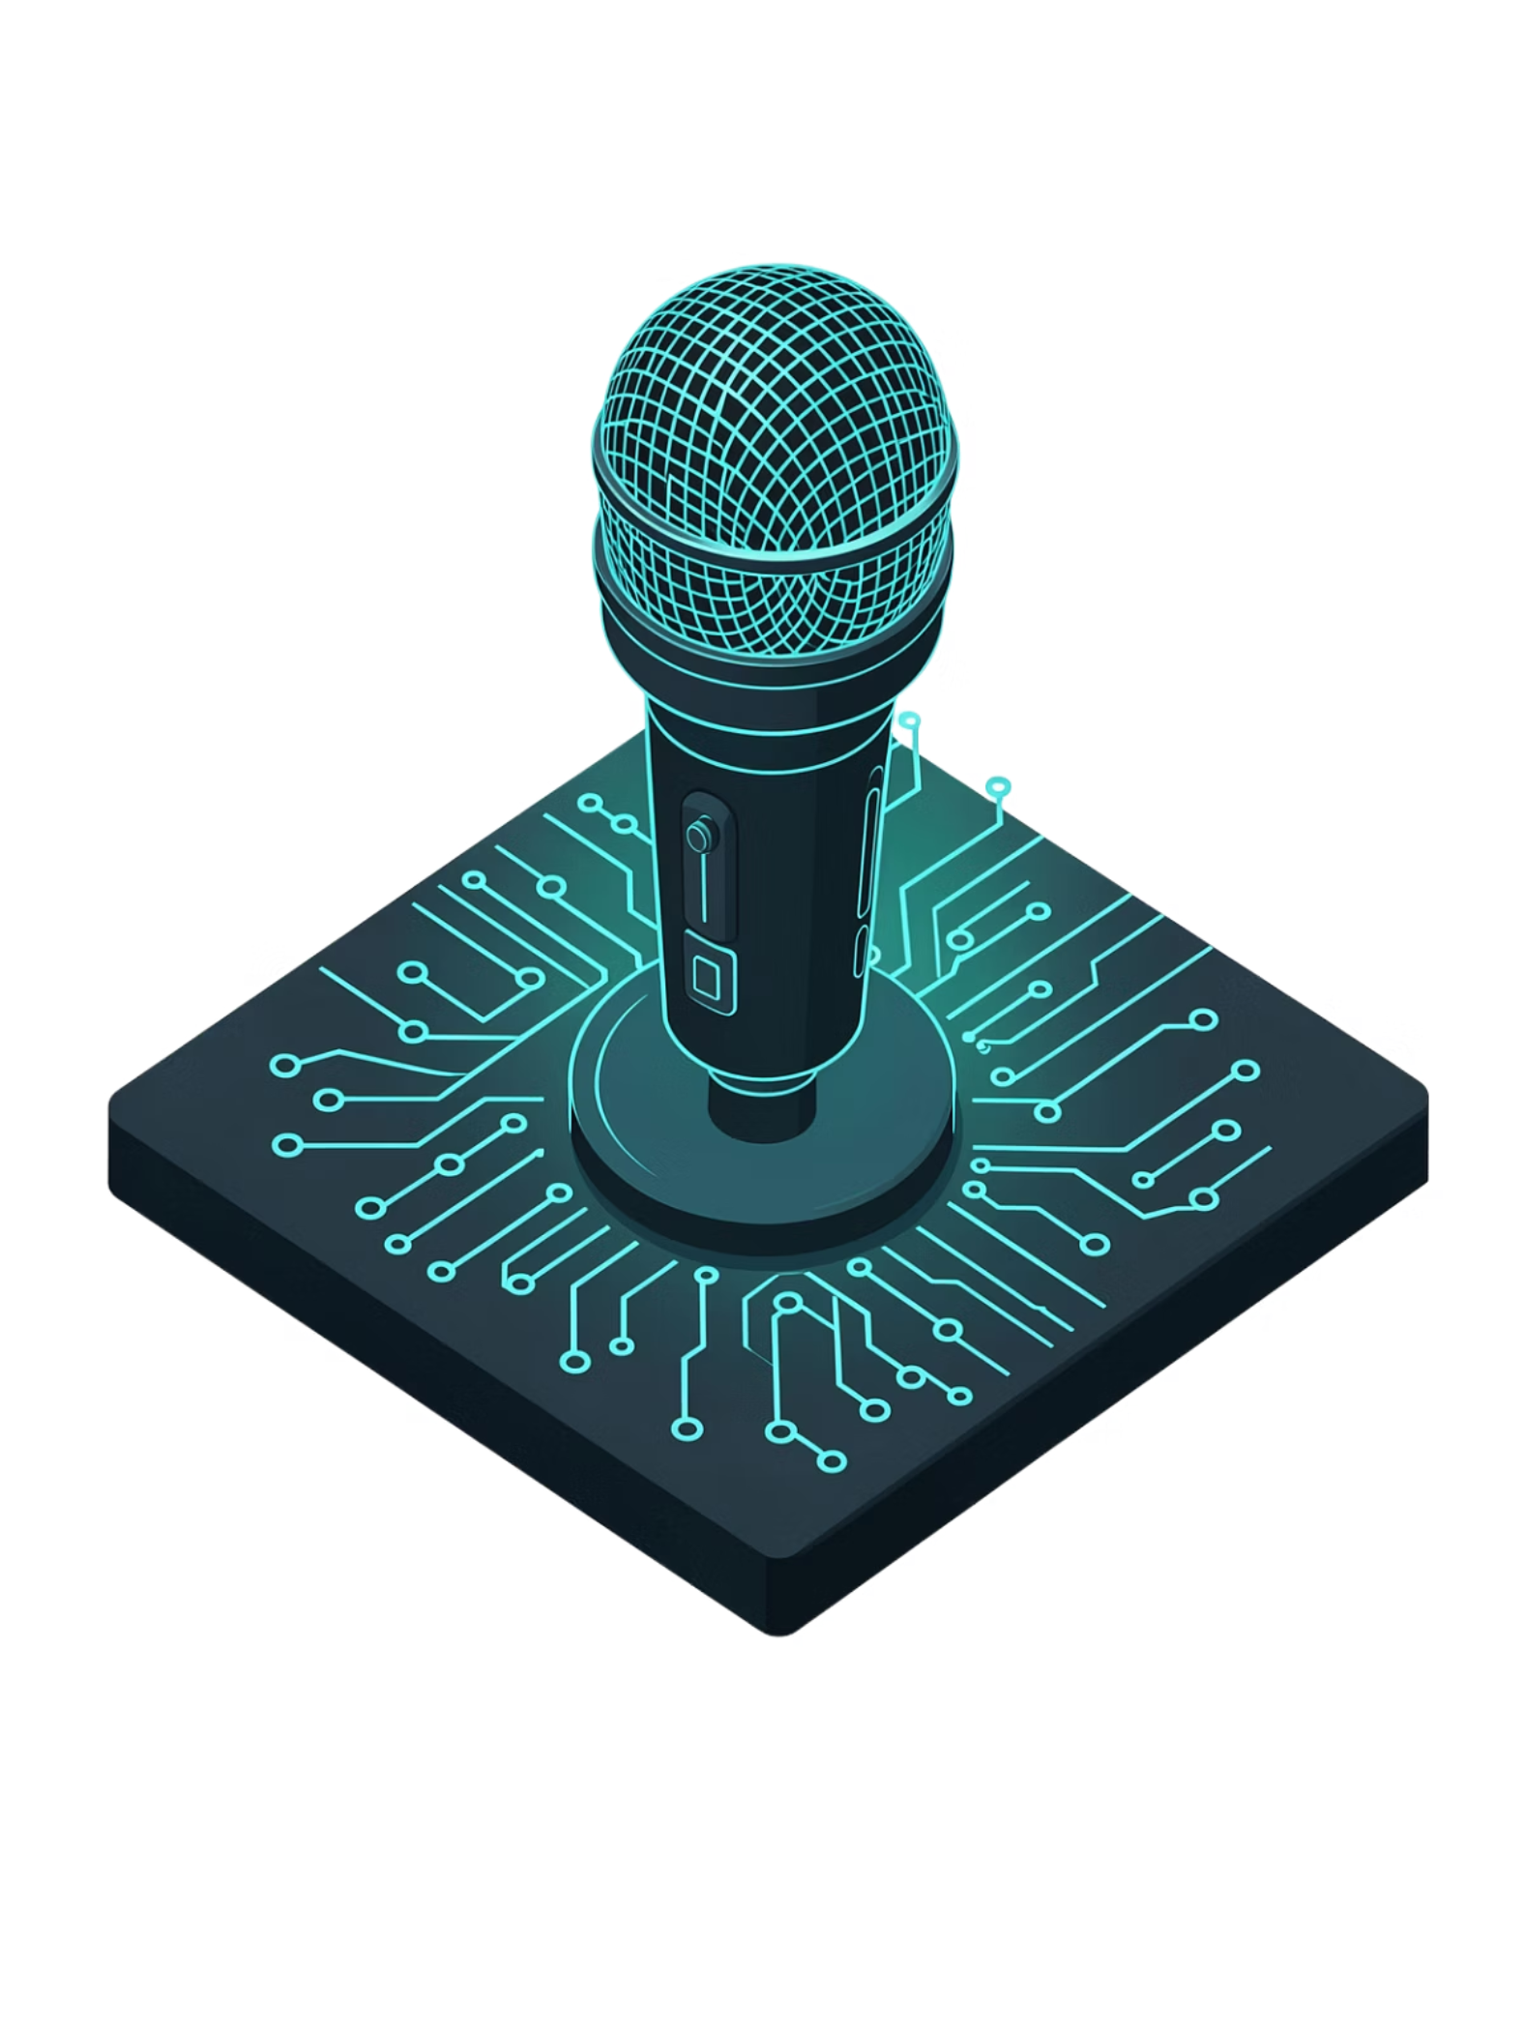
Introduction
AI Voice-Controlled Virtual Assistant
A privacy-first, locally-running Alexa-like assistant powered by Qwen AI and LM Studio — all computation stays on your machine.

Slide 3
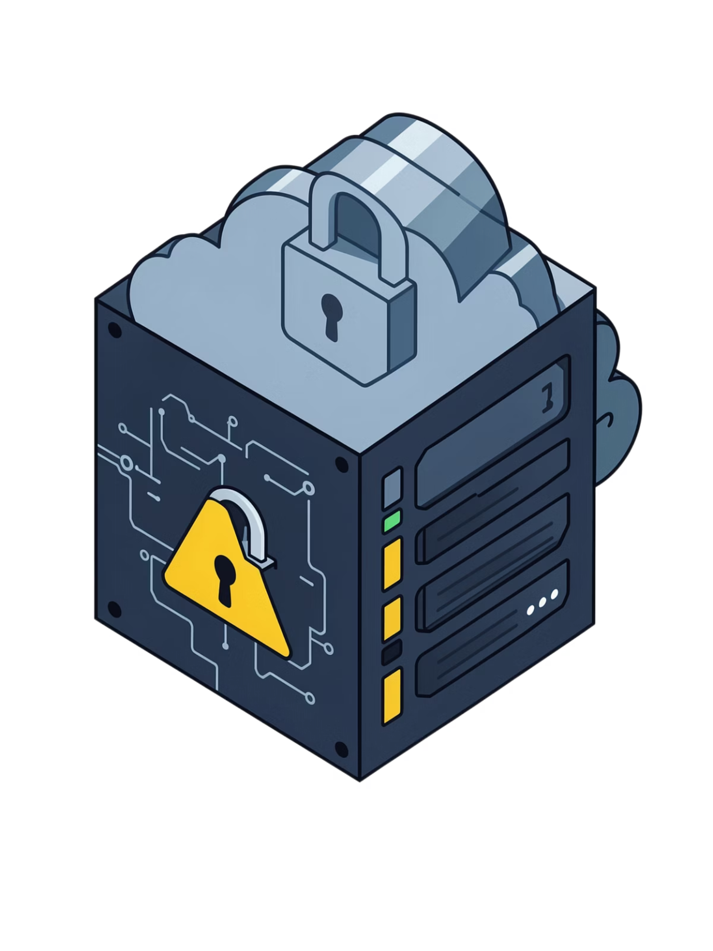
The Problem and Objective: Cloud Dependency & Privacy
Audio Exposure
Commercial voice assistants stream raw audio to remote cloud servers with every query.
Third-Party Data Risk
User voice data is processed and potentially retained by third-party service providers.
Always-Online Requirement
No internet connection means no assistant — a fundamental architectural fragility.
Limited Customization
Closed ecosystems prevent developers from modifying model behavior or extending capabilities.

Slide 4
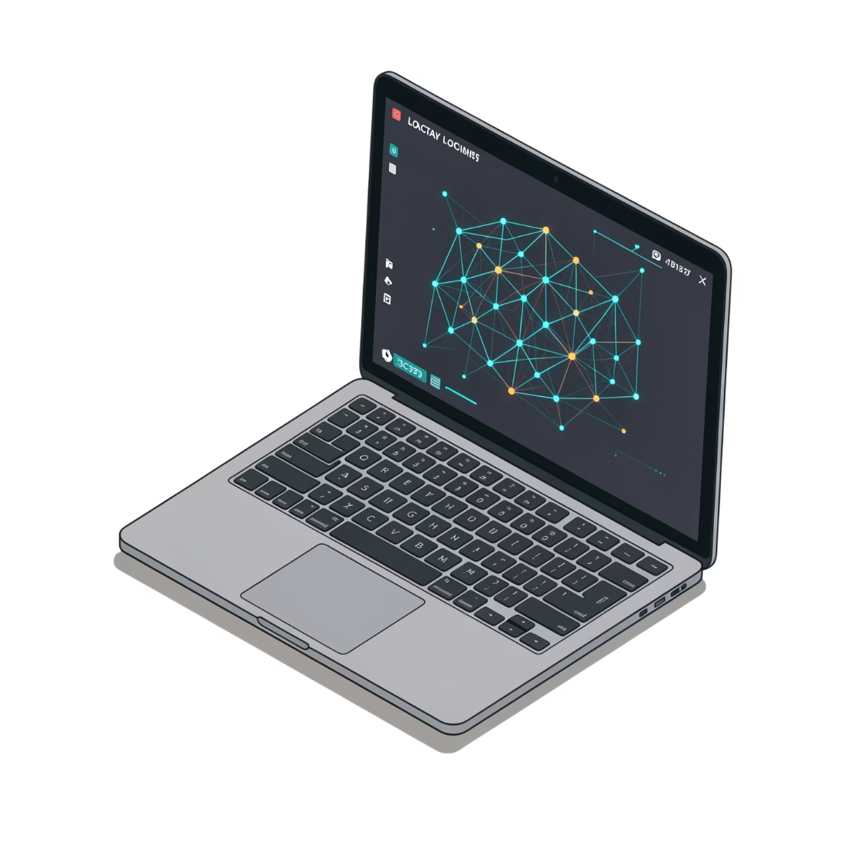

The Solution: Local-First Architecture
All processing on-device — no cloud calls, ever
Qwen AI model runs entirely via LM Studio on your hardware
Full voice privacy — your audio never leaves the machine
Fully customizable — modify prompts, behaviors, and pipelines freely
This is not a wrapper around a cloud API — it is a genuinely air-gapped intelligence stack.

Slide 5

Methodology
Capture & Transcribe
Synthesize Output
Orchestrate & Infer
Each component in the pipeline is fully offline. The Python orchestrator acts as the central nervous system, coordinating audio capture, transcription, inference, and playback without any external network calls.

Slide 6
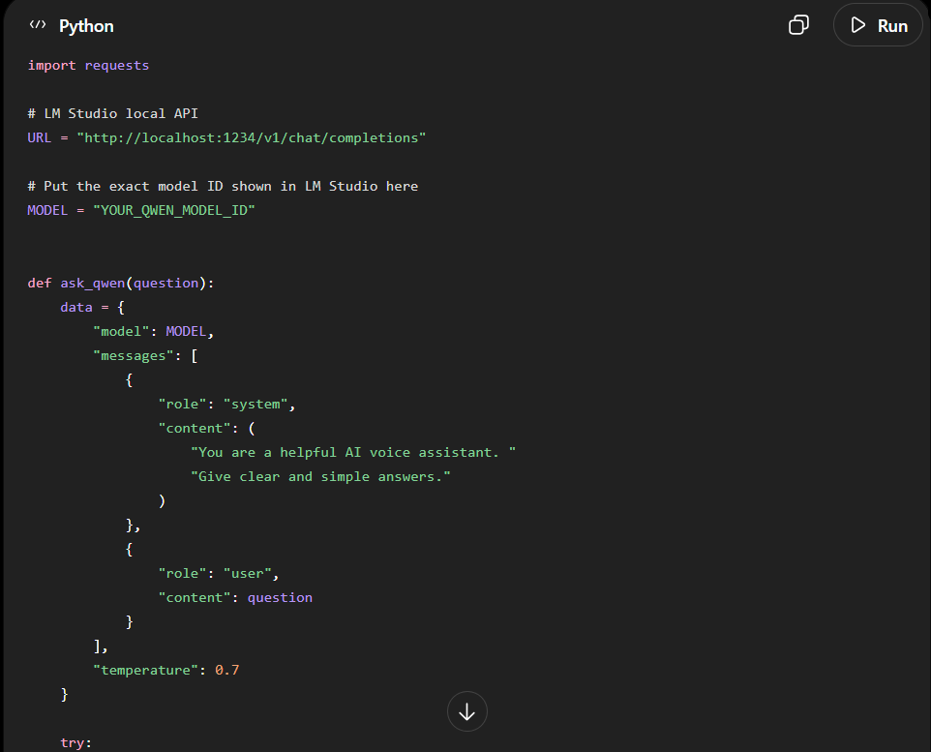

Slide 7
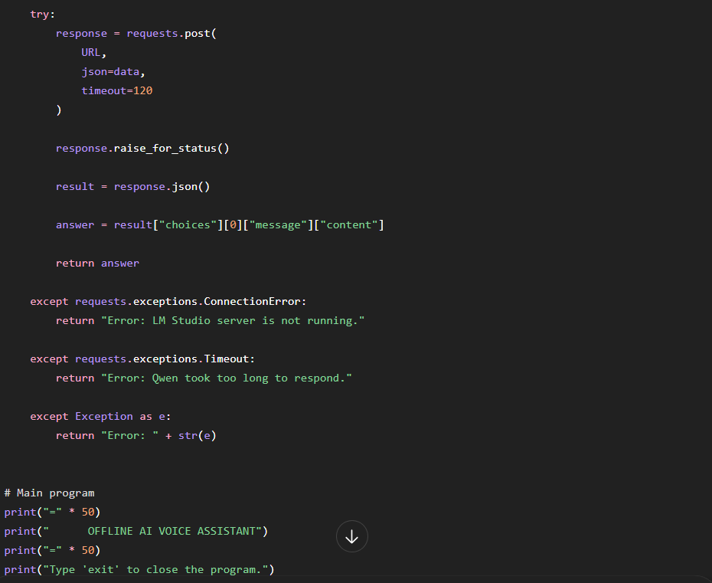

Slide 8
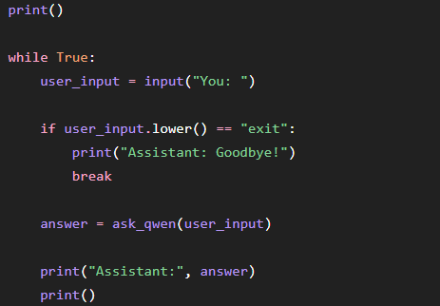

Slide 9
System Design
Speak
Transcribe
Route
User speaks a command or question into the microphone.
Faster-Whisper processes the audio buffer and outputs a text transcript — fully offline.
Python sends the transcribed text to the LM Studio local REST API endpoint.
Infer
Speak Back
Qwen processes the prompt and generates a contextually aware response.
Text-to-speech (Piper or pyttsx3) synthesizes audio and the speaker plays the response.

Slide 10
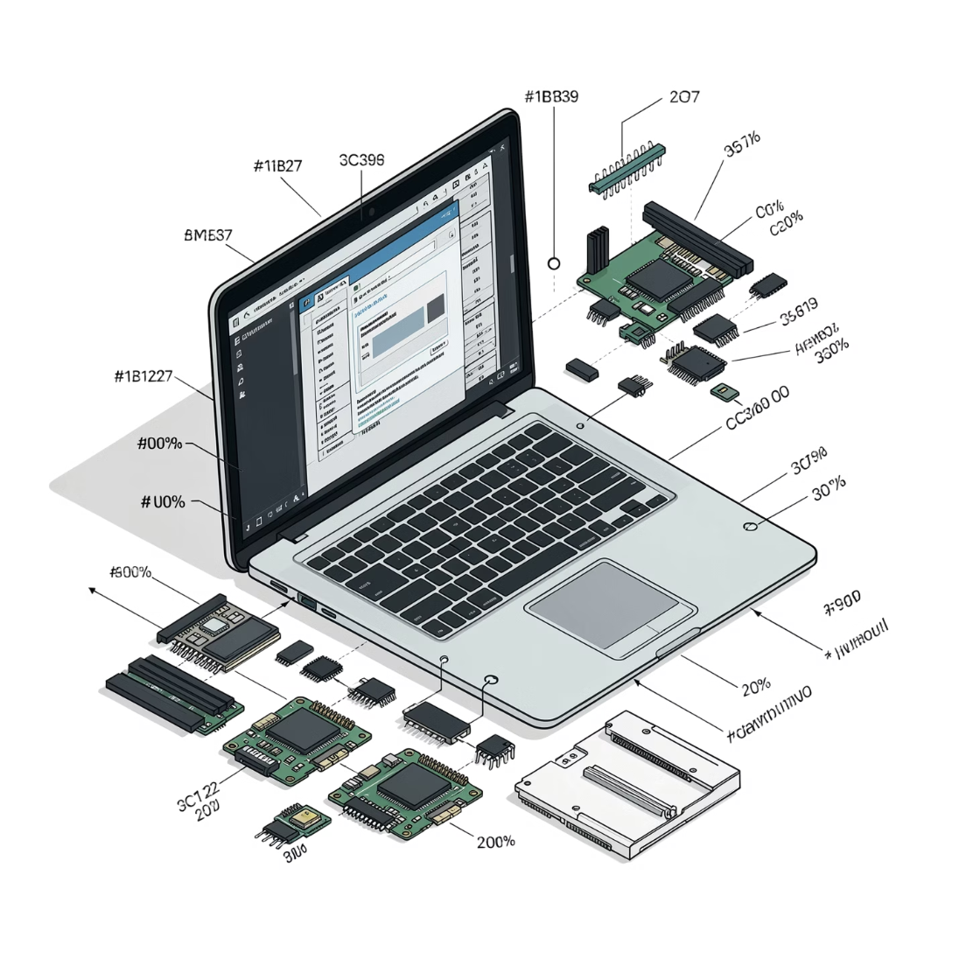
Hardware Requirements
Microphone & Speaker
RAM
GPU (Optional)
Minimum 8 GB to run the stack. 16 GB recommended for smooth Qwen inference.
CUDA-compatible GPU significantly reduces response latency. CPU-only is fully supported.
Any standard laptop mic and audio output — no specialized hardware needed.

Slide 11

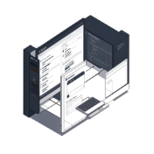
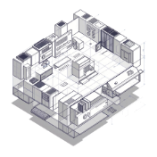
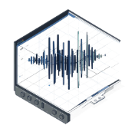
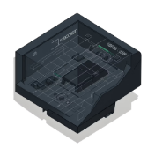
Software Stack
Python 3.x
LM Studio
Qwen Model
Faster-Whisper
Main orchestration language — coordinates all components via clean, modular scripts.
Hosts the Qwen model locally and exposes an OpenAI-compatible REST API for inference.
Handles natural language understanding and response generation entirely on-device.
High-performance offline speech-to-text — CTranslate2-optimized Whisper inference.
Piper / pyttsx3
Offline text-to-speech engines. Piper for high-quality neural voices; pyttsx3 for lightweight fallback.

Slide 12
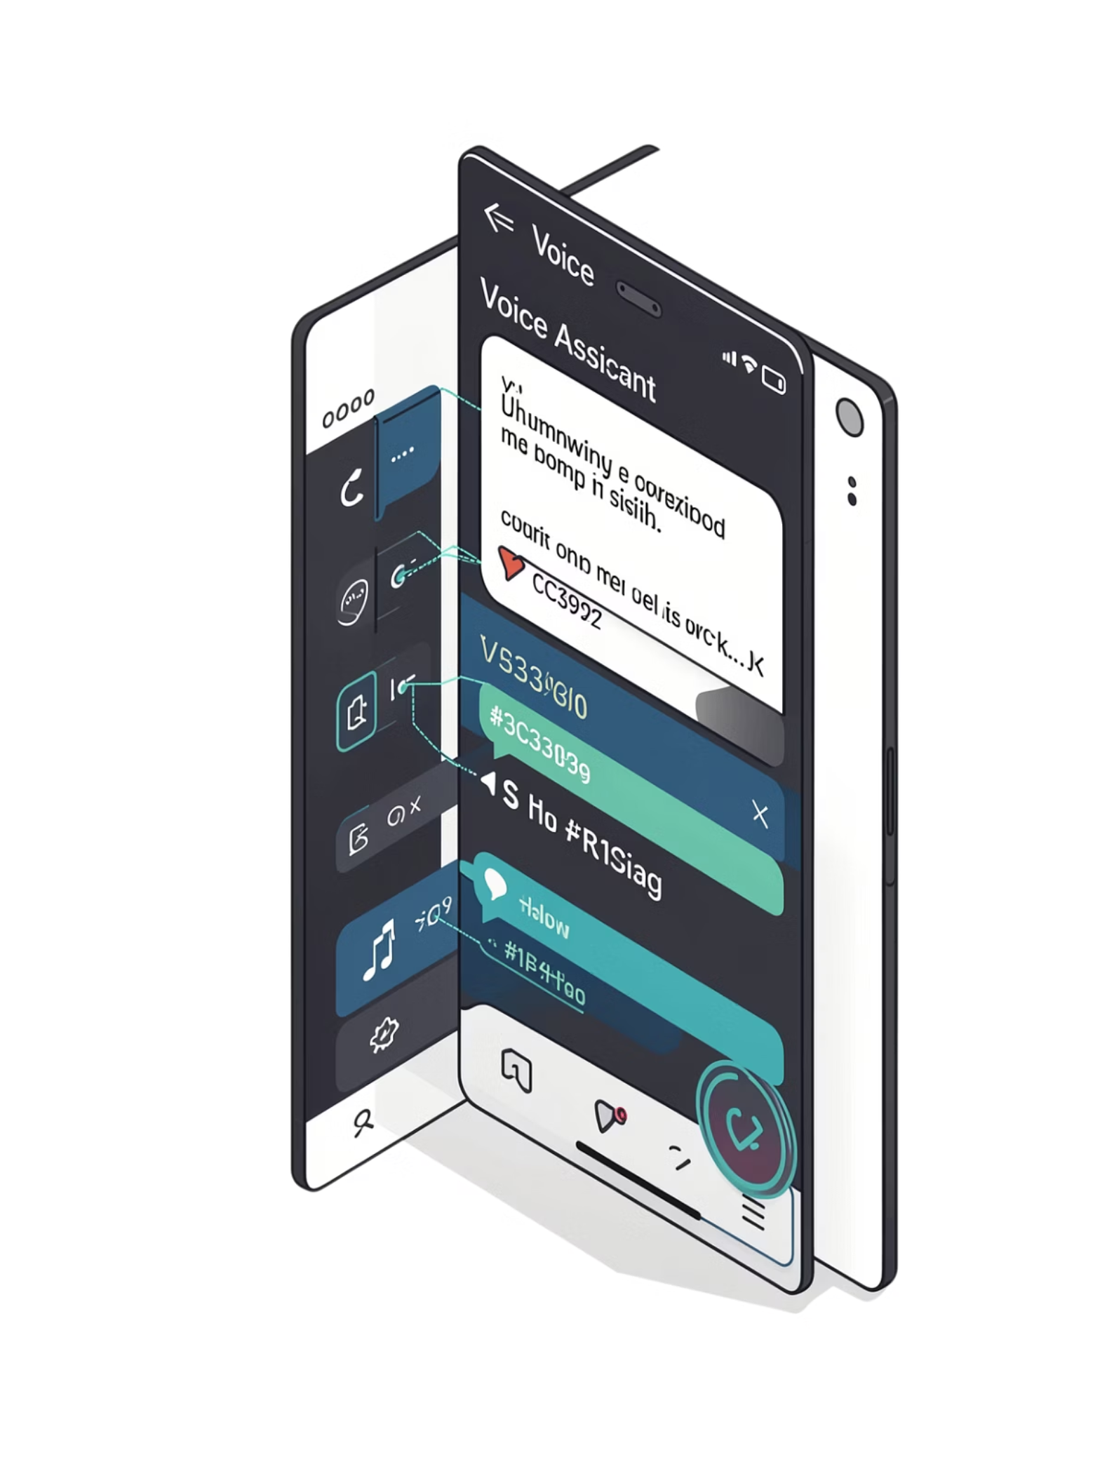
Core Capabilities and Implementation (MVP)
Q&A
Answer questions using Qwen's built-in knowledge base — no internet lookup required.
Time & Date
Retrieve and report current time and date from the local system clock.
App & Web Launch
Open applications and URLs via parsed voice commands and Python subprocess calls.
System Commands
Execute shell-level system operations — file management, process control, and more.

Slide 13
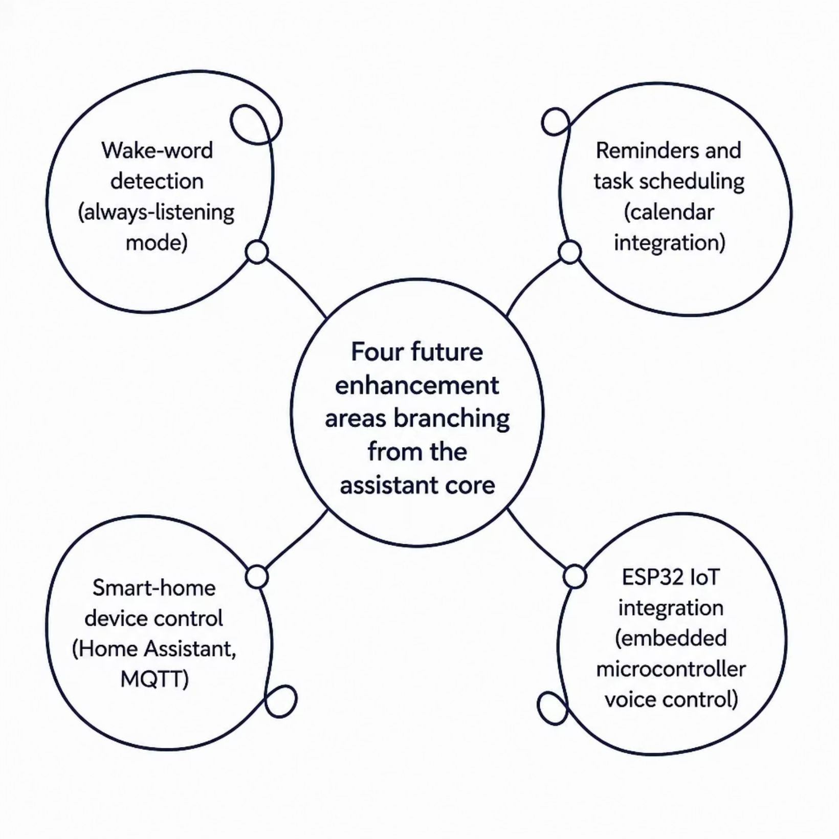
Future Enhancements
Wake-word detection — always-listening mode triggered by a custom hotword, no button press needed
Reminders & scheduling — natural language task creation integrated with local calendar systems
Smart-home control — send commands to local home automation hubs (Home Assistant, MQTT)
ESP32 IoT integration — extend voice control to embedded microcontroller devices over serial or Wi-Fi

Slide 14
The Advantage of Voice controlled Virtual assaistant
Privacy
Customization
Zero cloud dependency. Voice data never leaves the device — no logs, no telemetry, no exposure.
Modify Qwen system prompts, swap models, and extend behaviors to fit any use case.
Offline-First
Zero Cost
Fully functional without an internet connection. Reliable in restricted or air-gapped environments.
No API fees, no subscriptions, no rate limits. Run inference as often as needed at no marginal cost.

Slide 15
The Uses of our project
AI-Assistance – Answer questions, tell time/date, and perform voice commands.
Education – Help students with explanations, study-related questions, and learning tasks.
Desktop Automation – Open applications, websites, files, and perform system operations.
Privacy-Sensitive Environments – Useful where voice data should remain on the local device.
IoT & Smart Homes – Can be extended to control ESP32 and other local devices.

Slide 16
REFERENCES
• Python Official Documentation – Python 3.x • LM Studio Documentation – Local LLM and REST API • Qwen – Large Language Model Documentation • Faster-Whisper – Offline Speech-to-Text • Piper – Offline Neural Text-to-Speech • pyttsx3 – Python Text-to-Speech Library

Slide 17


